Slide 1
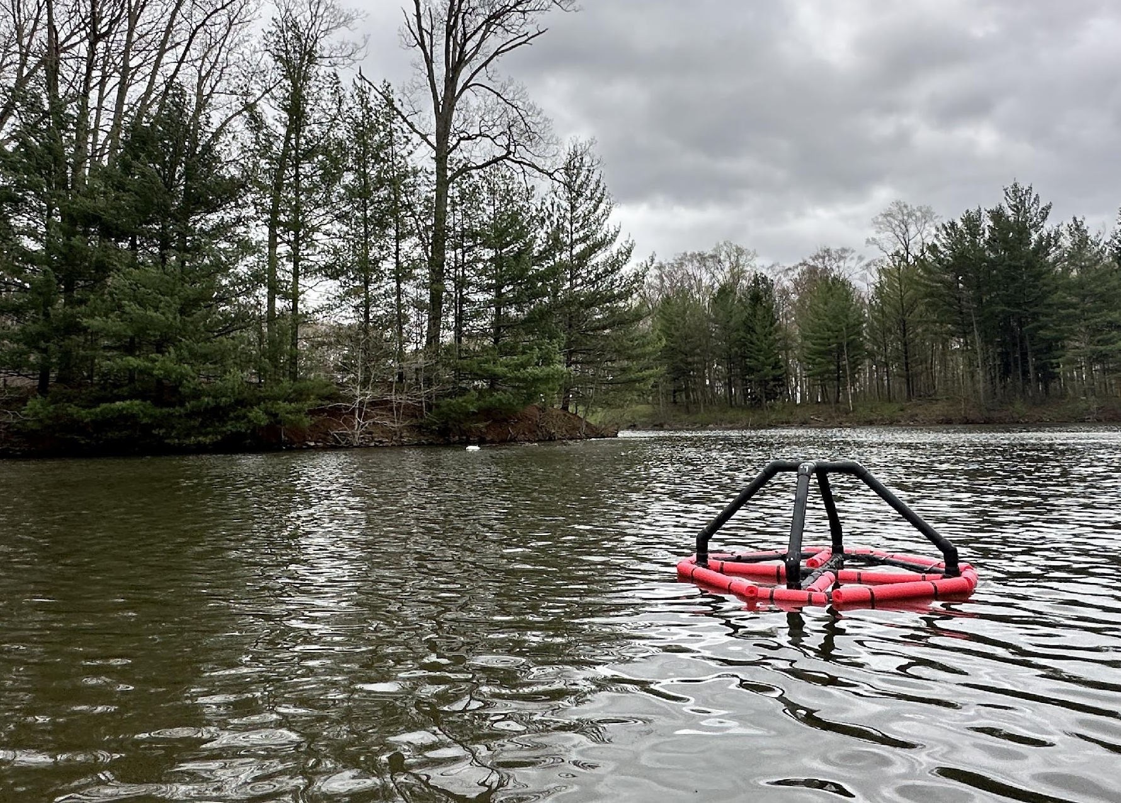
Strnad Presentation: Lake Kilroy Buoy and Water Quality Project
Sam Mathews and Vir Patel

Slide 2



Overview
BUOY
WATER QUALITY
DATA/RESEARCH

Slide 3

Buoy
Create a buoy to float on Lake Kilroy
House 2 water quality sensor units at different depths + ESP32 hardware + solar panel

Slide 4



Water Quality
Use a sensor unit to measure pH, dissolved oxygen, conductivity, and temperature using an Atlas Scientific kit
Use ESP32 microcontrollers to collect the data and upload the data to ThingSpeak so anyone who wants to can have access to the data

Slide 5
Data/Research
Use the data to observe pond turnover in Lake Kilroy
Use data for other classes to help learn about the lake and different statistics
Worked with ecology in the past

Slide 6
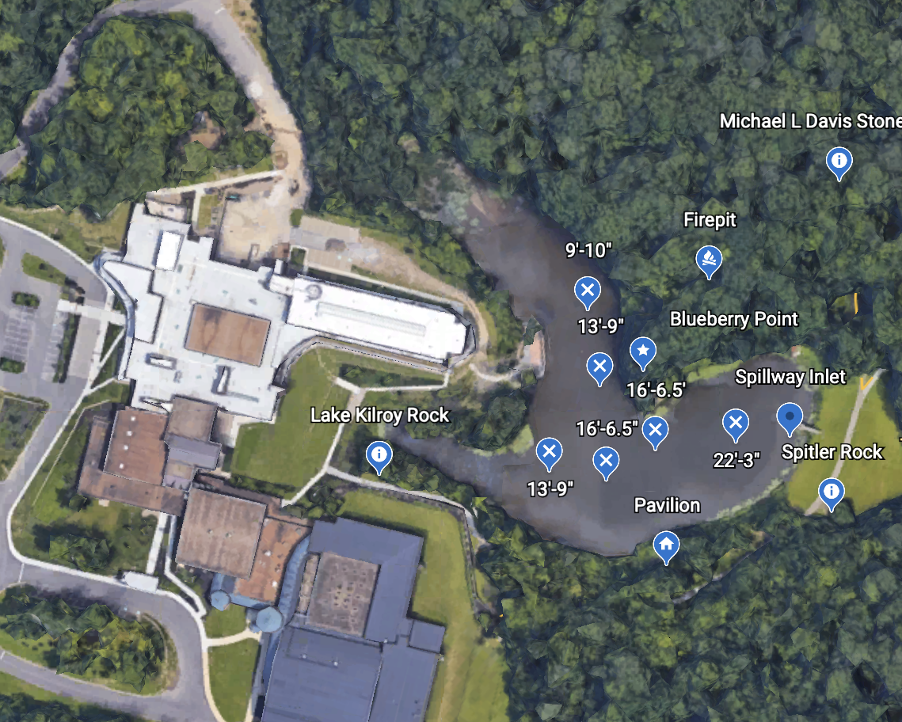
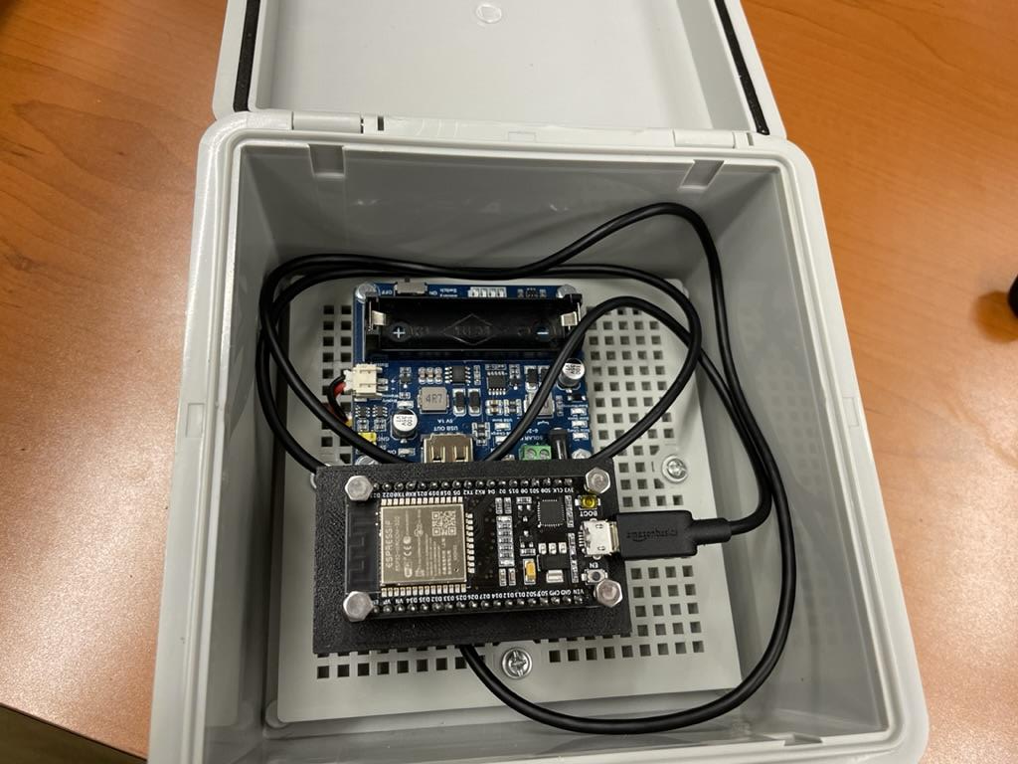
General Tasks and Work
We have also established where we will place the buoy (we found the deepest part of Lake Kilroy, so we can get two distinct depths)
We have also construed a contraption to house the ESP32 and measured its range, so we know where to place them

Slide 7
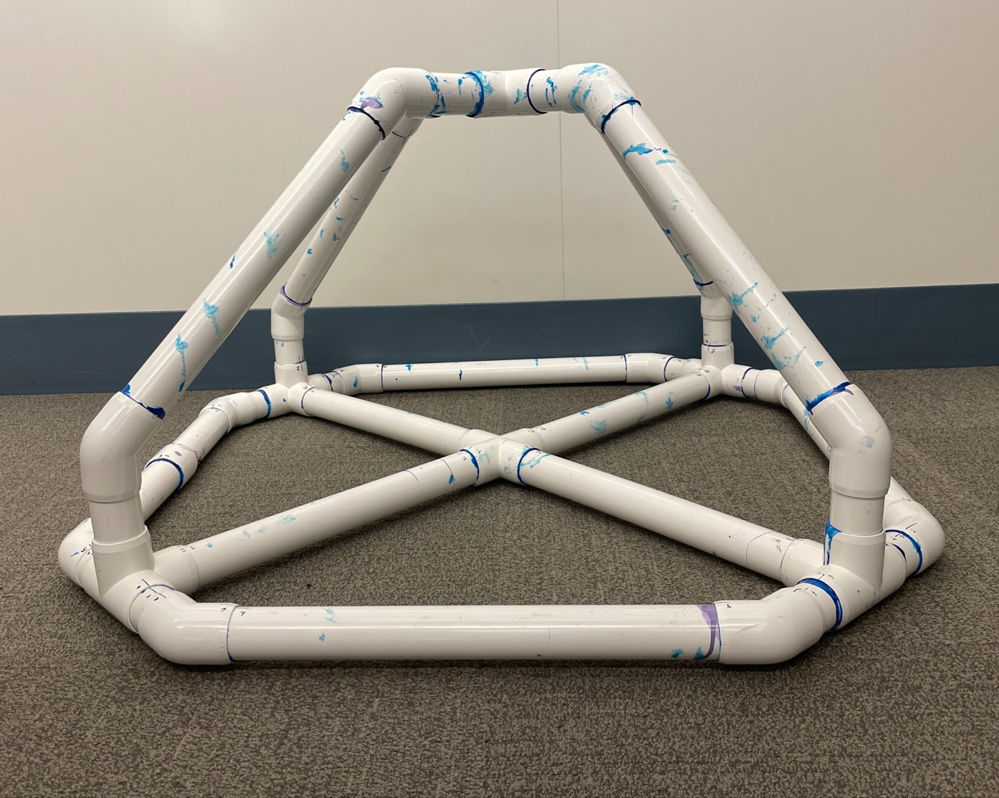
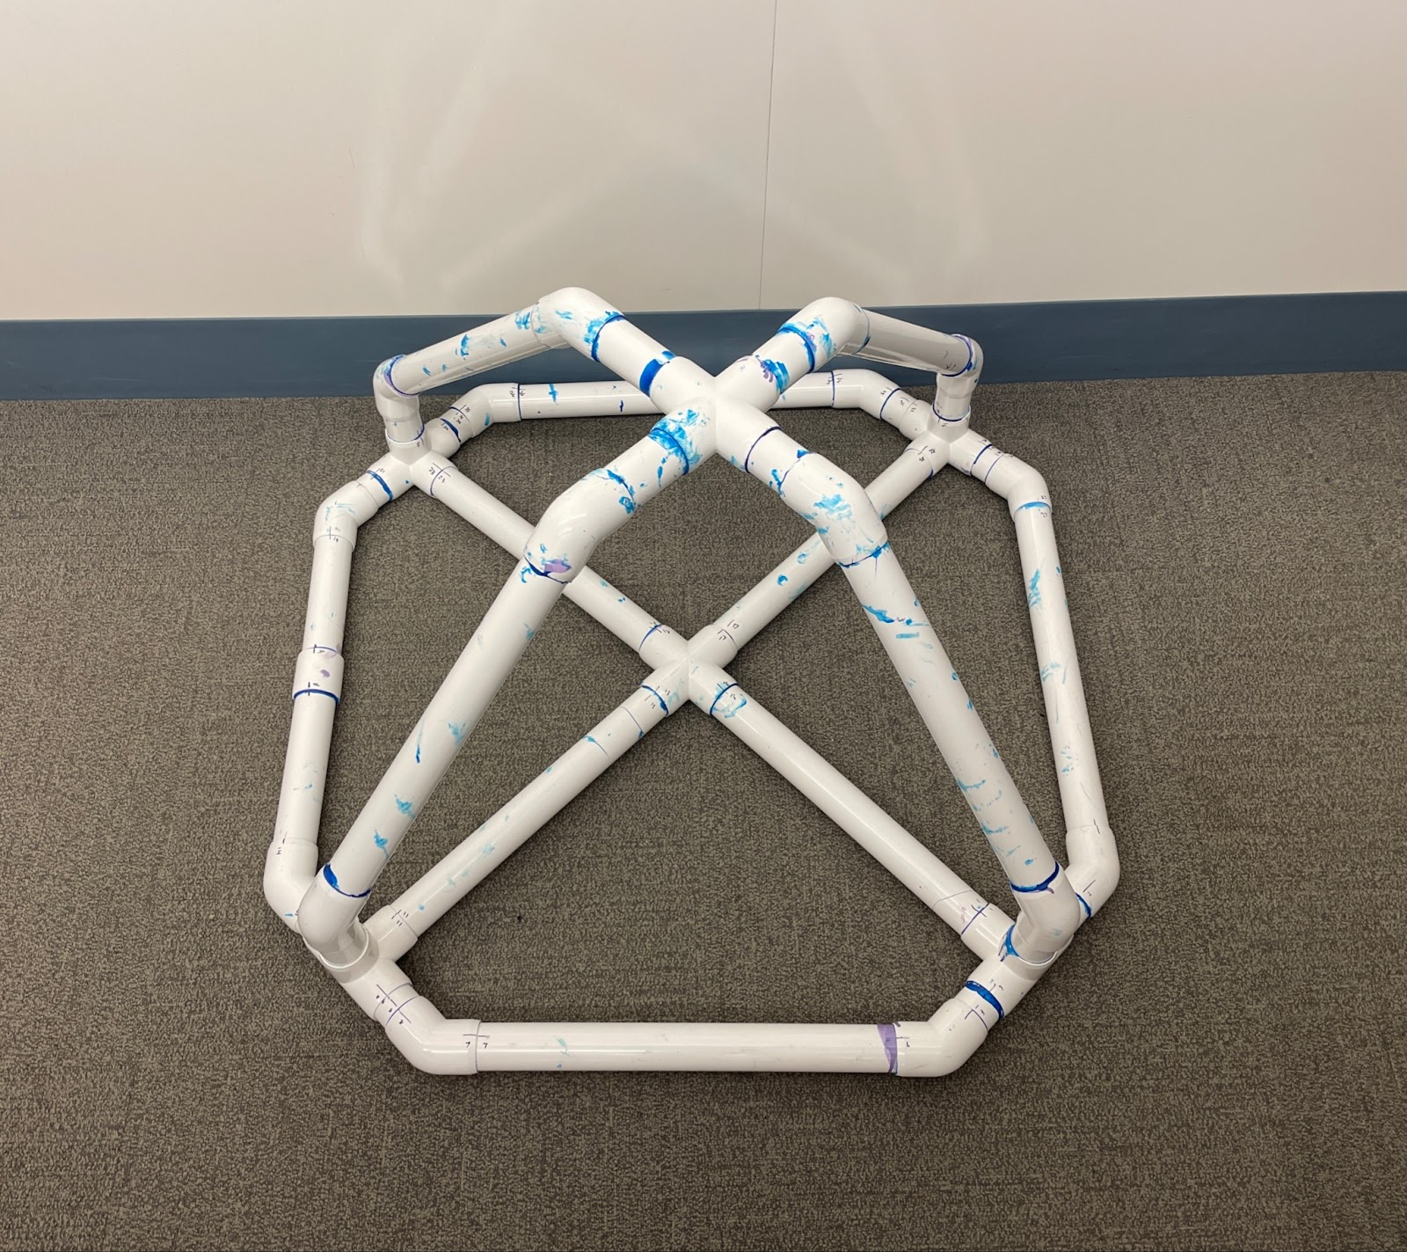
Buoy
This is the construction of the buoy out of PVC pipes
At this point the top and bottom halves are glued separately

Slide 8
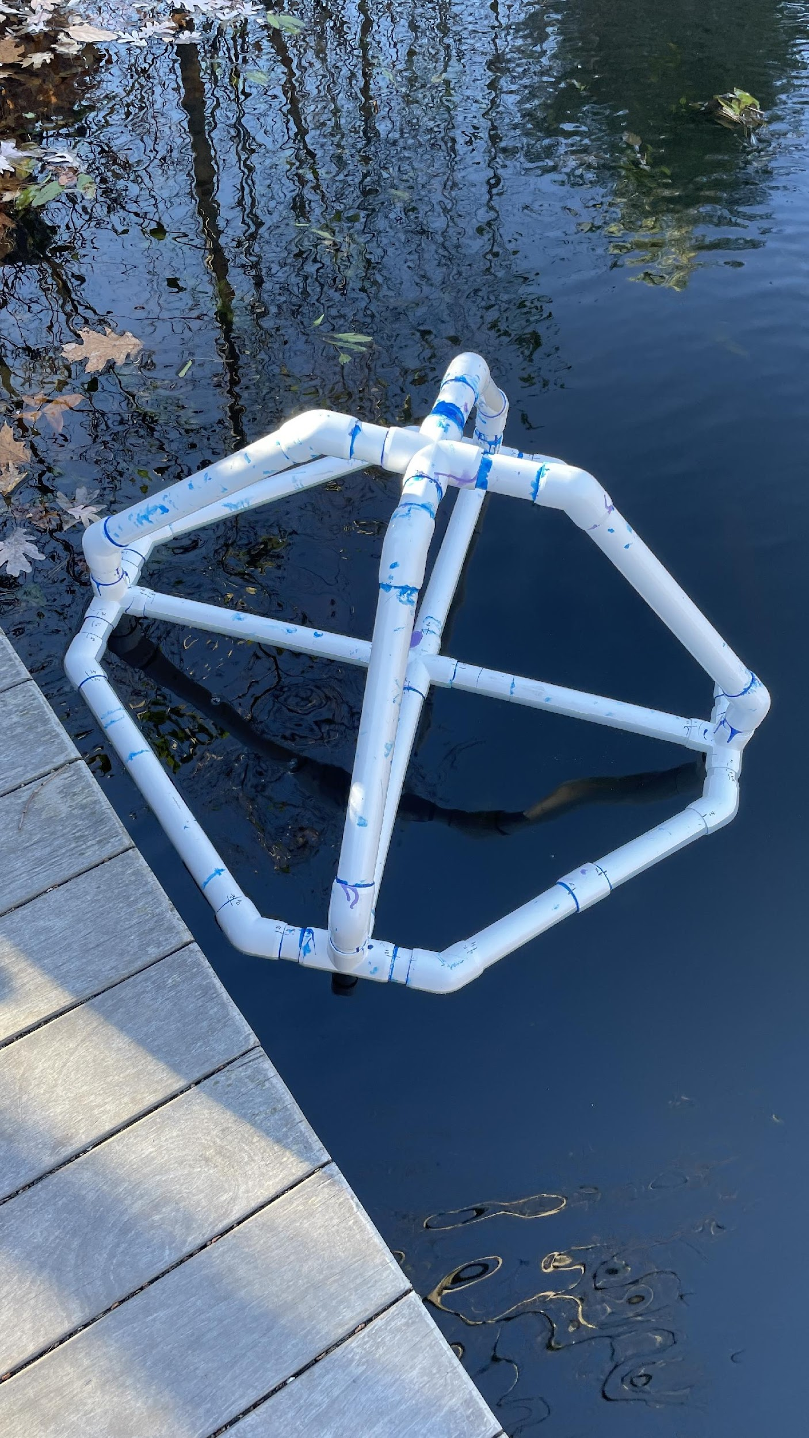
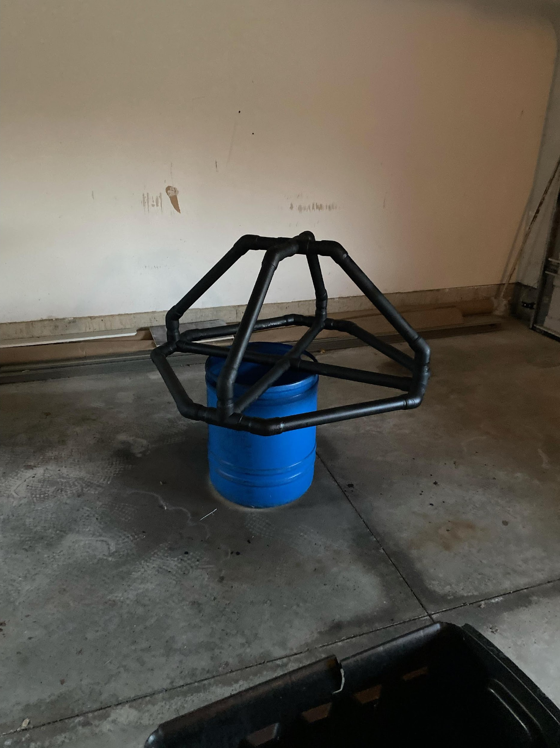
Pictures of Buoy Floating/Spray Paint
Now the buoy is completely glued together
It has a black coated paint
It can also float

Slide 9
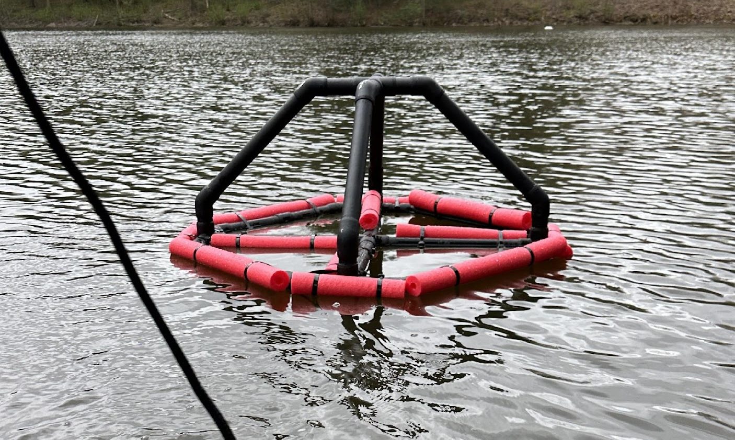
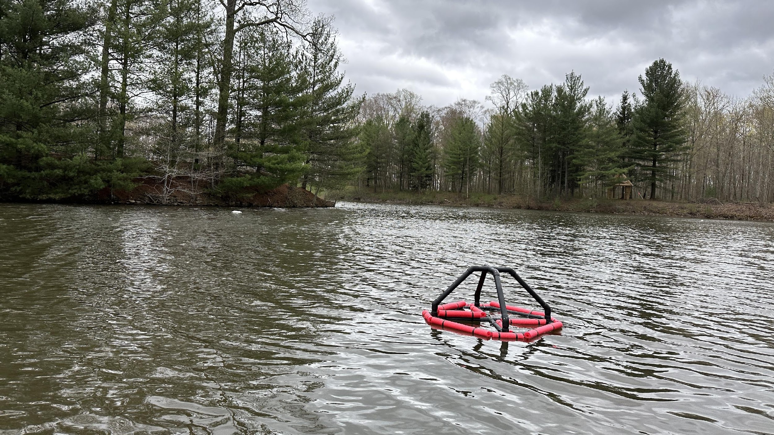
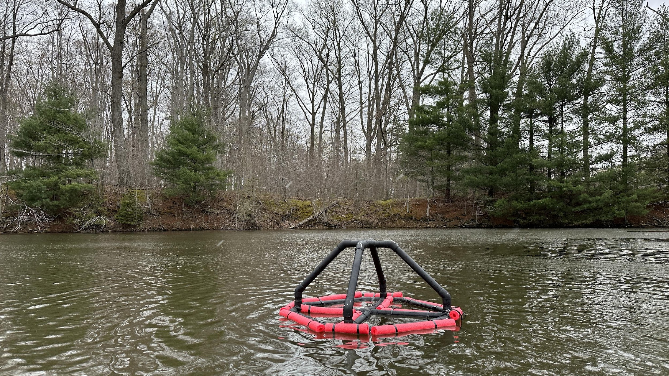
Buoy Floating
The Buoy was fully sealed with Caulk and Flex Seal
Pool noodles were attached to the buoy for buoyancy
It floats completely on its own

Slide 10
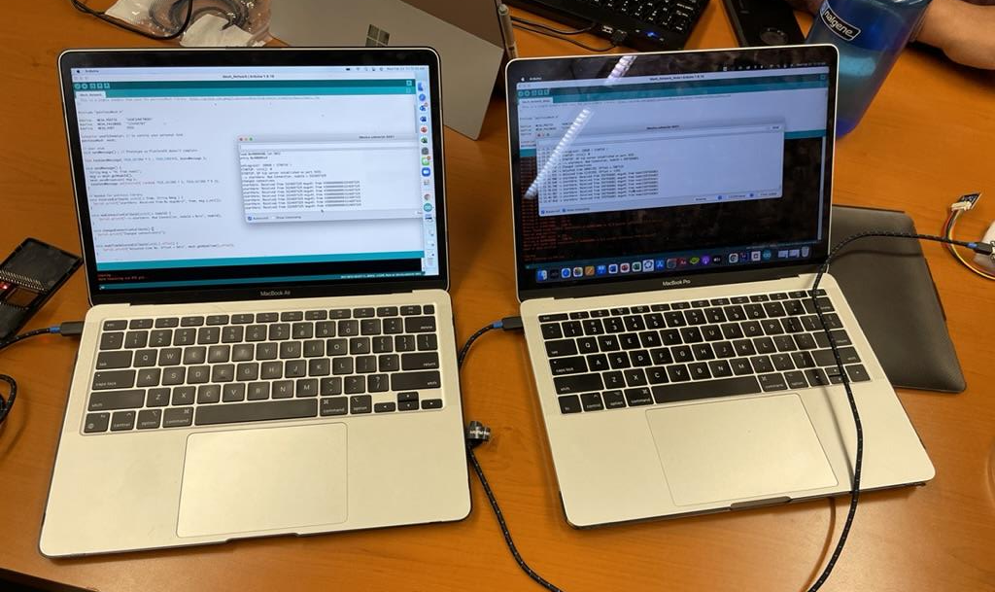
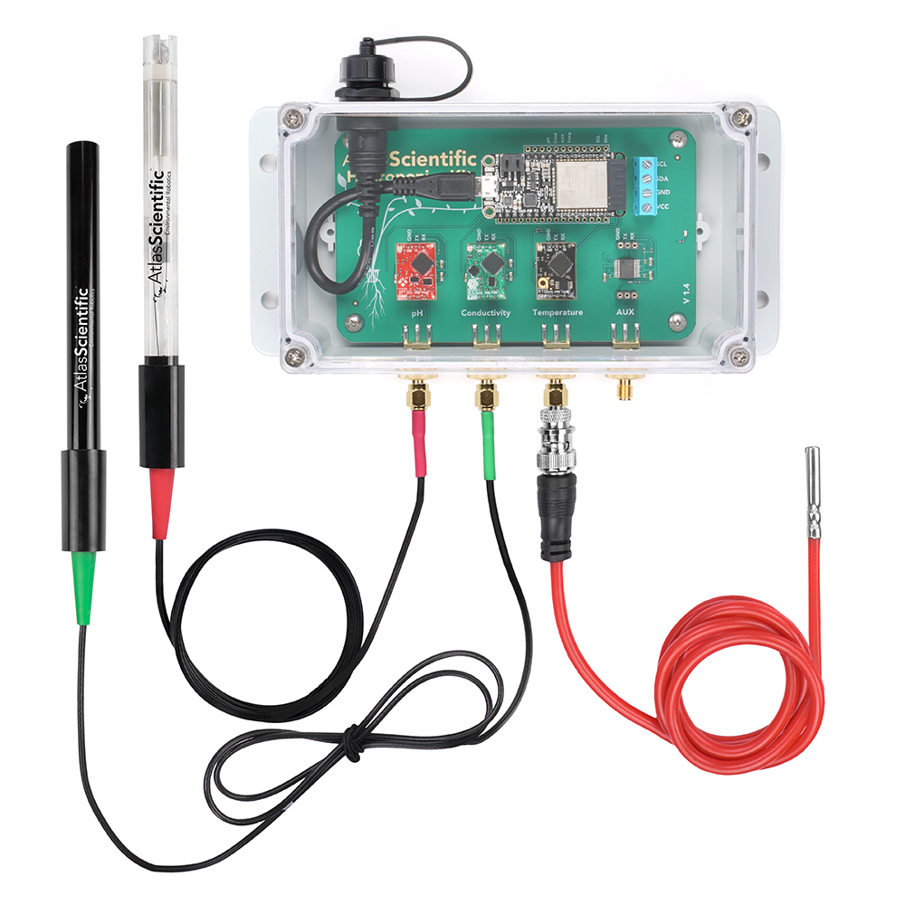
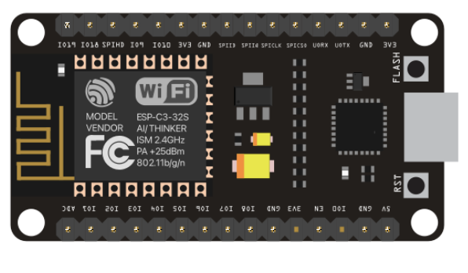
Coding and Water Quality
We have the sensor unit, which is essentially all we needed
It has all of the probes for pH, dissolved oxygen, conductivity, and temperature
This is where we have gotten stuck the most
Our coding consists of three phases
1) Mesh Network
2) MQTT
3) Antenna/Long Distance

Slide 11
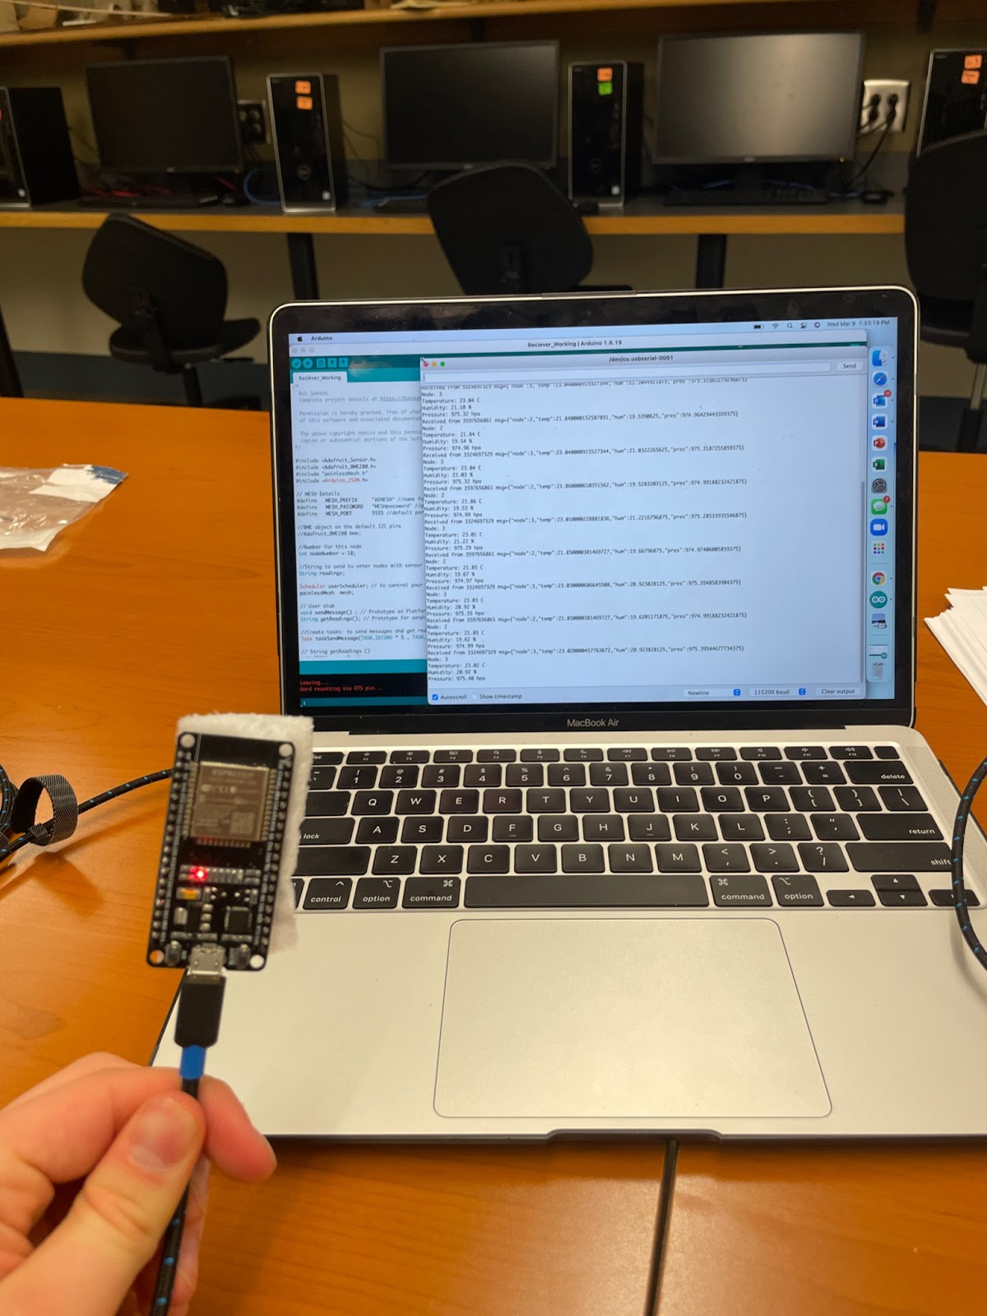
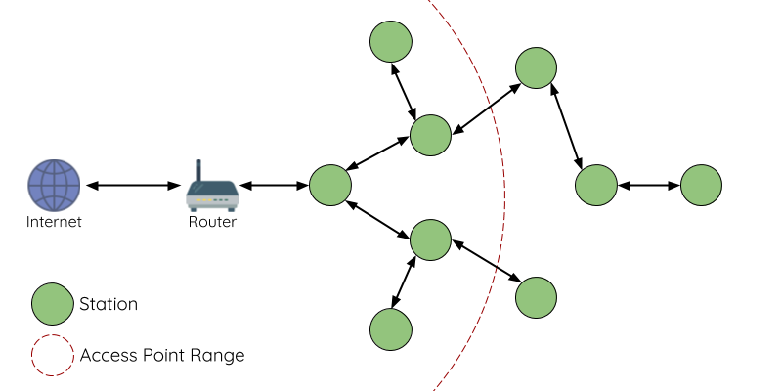
Coding Mesh Network
Our first goal was to create a mesh network amongst ESP32 microcontrollers to upload to ThingSpeak
A mesh network is a Bluetooth connection among chips so they can communicate

Slide 12
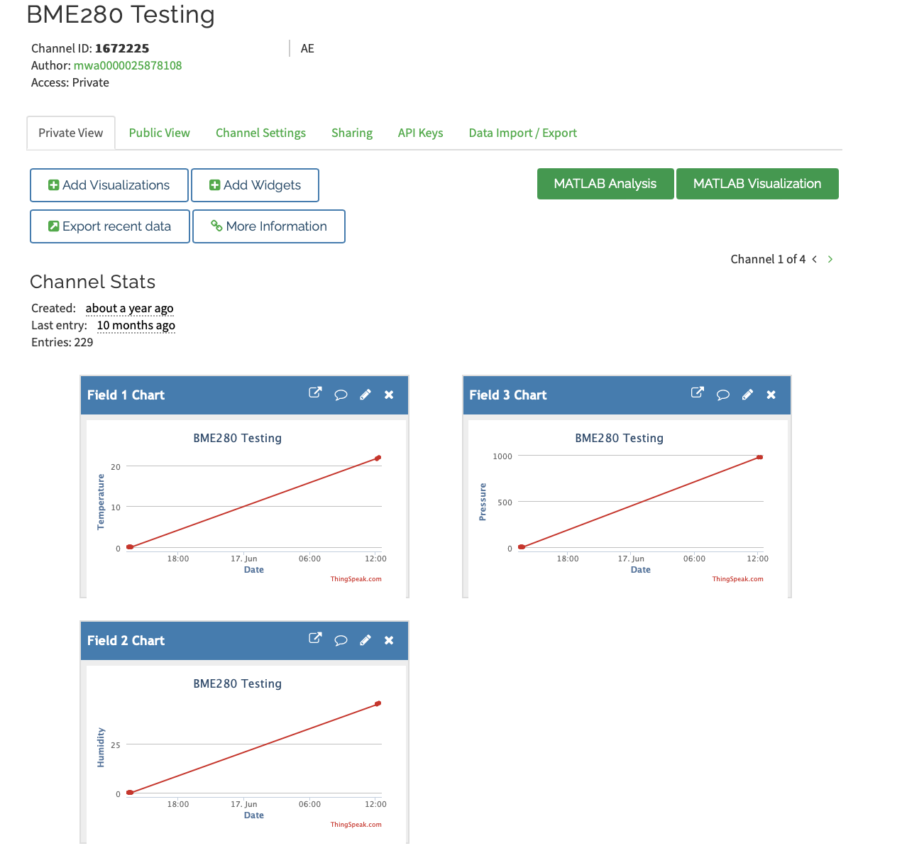
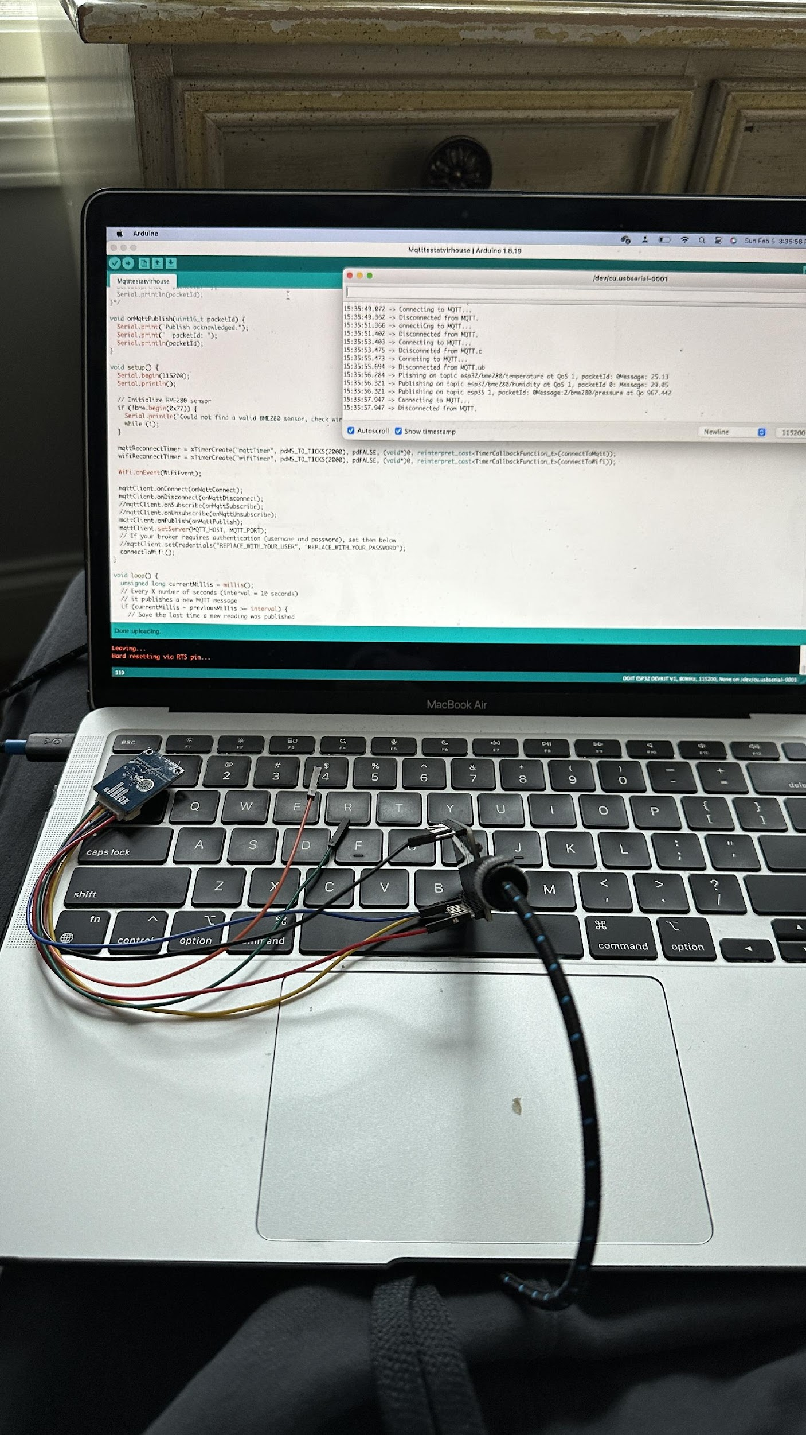
Coding Mesh Network
We were able to establish a stable connection to ThingSpeak from an ESP32 and upload data
We were also able to create a mesh network between ESP32 chips
However there was a timing problem with the mesh network and ThingSpeak code since they used different timers

Slide 13
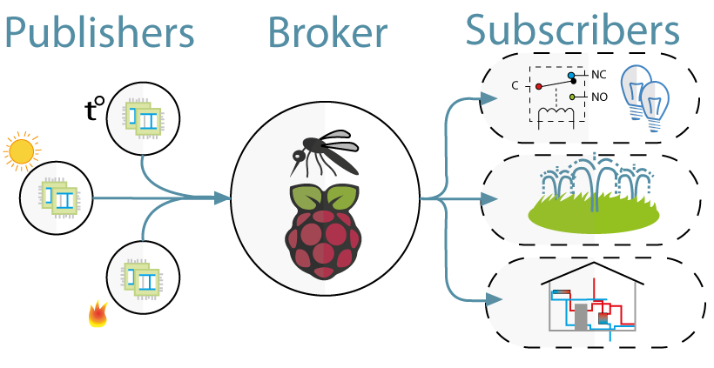
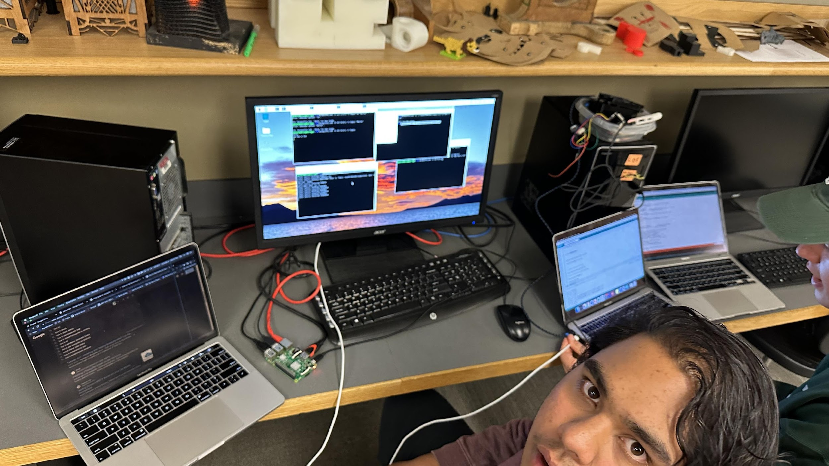
Transition to Raspberry Pi + MQTT
Next we turned to a Raspberry Pi MQTT with Mosquitto
Essentially, the Raspberry Pi was a broker where the ESP32 could send data and ThingSpeak could subscribe to collect the data
We could not find enough code to make this work

Slide 14
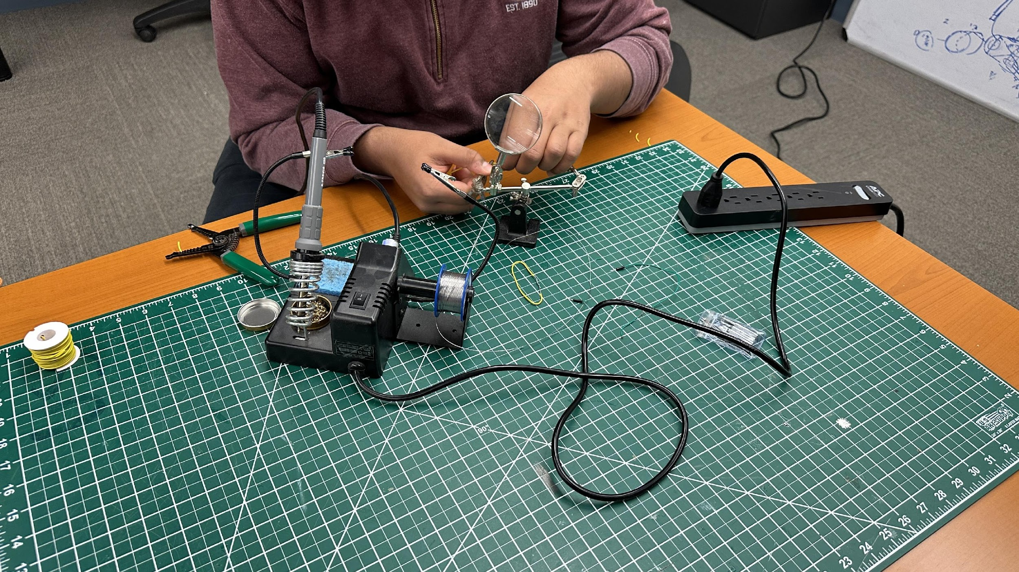
Code Antenna
Now we are going to add an antenna to the ESP32 to enhance its range
This way we can directly upload to ThingSpeak without a mesh network or MQTT

Slide 15
Transition to Raspberry Pi + MQTT
Next we turned to a Raspberry Pi MQTT with Mosquitto
Essentially, the Raspberry Pi was a broker where the ESP32 could send data and ThingSpeak could subscribe to collect the data
We could not find enough code to make this work

Slide 16
Soft Launch
Now we are going to add an antenna to the ESP32 to enhance its range
This way we can directly upload to ThingSpeak without a mesh network or MQTT

Slide 17
Transition to Raspberry Pi + MQTT
Next we turned to a Raspberry Pi MQTT with Mosquitto
Essentially, the Raspberry Pi was a broker where the ESP32 could send data and ThingSpeak could subscribe to collect the data
We could not find enough code to make this work

Slide 18
Soft Launch
Now we are going to add an antenna to the ESP32 to enhance its range
This way we can directly upload to ThingSpeak without a mesh network or MQTT

Slide 19
Transition to Raspberry Pi + MQTT
Next we turned to a Raspberry Pi MQTT with Mosquitto
Essentially, the Raspberry Pi was a broker where the ESP32 could send data and ThingSpeak could subscribe to collect the data
We could not find enough code to make this work

Slide 20
Soft Launch
Now we are going to add an antenna to the ESP32 to enhance its range
This way we can directly upload to ThingSpeak without a mesh network or MQTT

Slide 21


Challenges Faced
WIFI BARRIERS AND FIRE WALL
MESH NETWORK CODE

Slide 22
Collaborations
Nate Abbott helped us in our work – he is doing another Strnad where the mesh network would have been useful
We plan to work with other classes as well like biology, ecology, and statistics

Slide 23

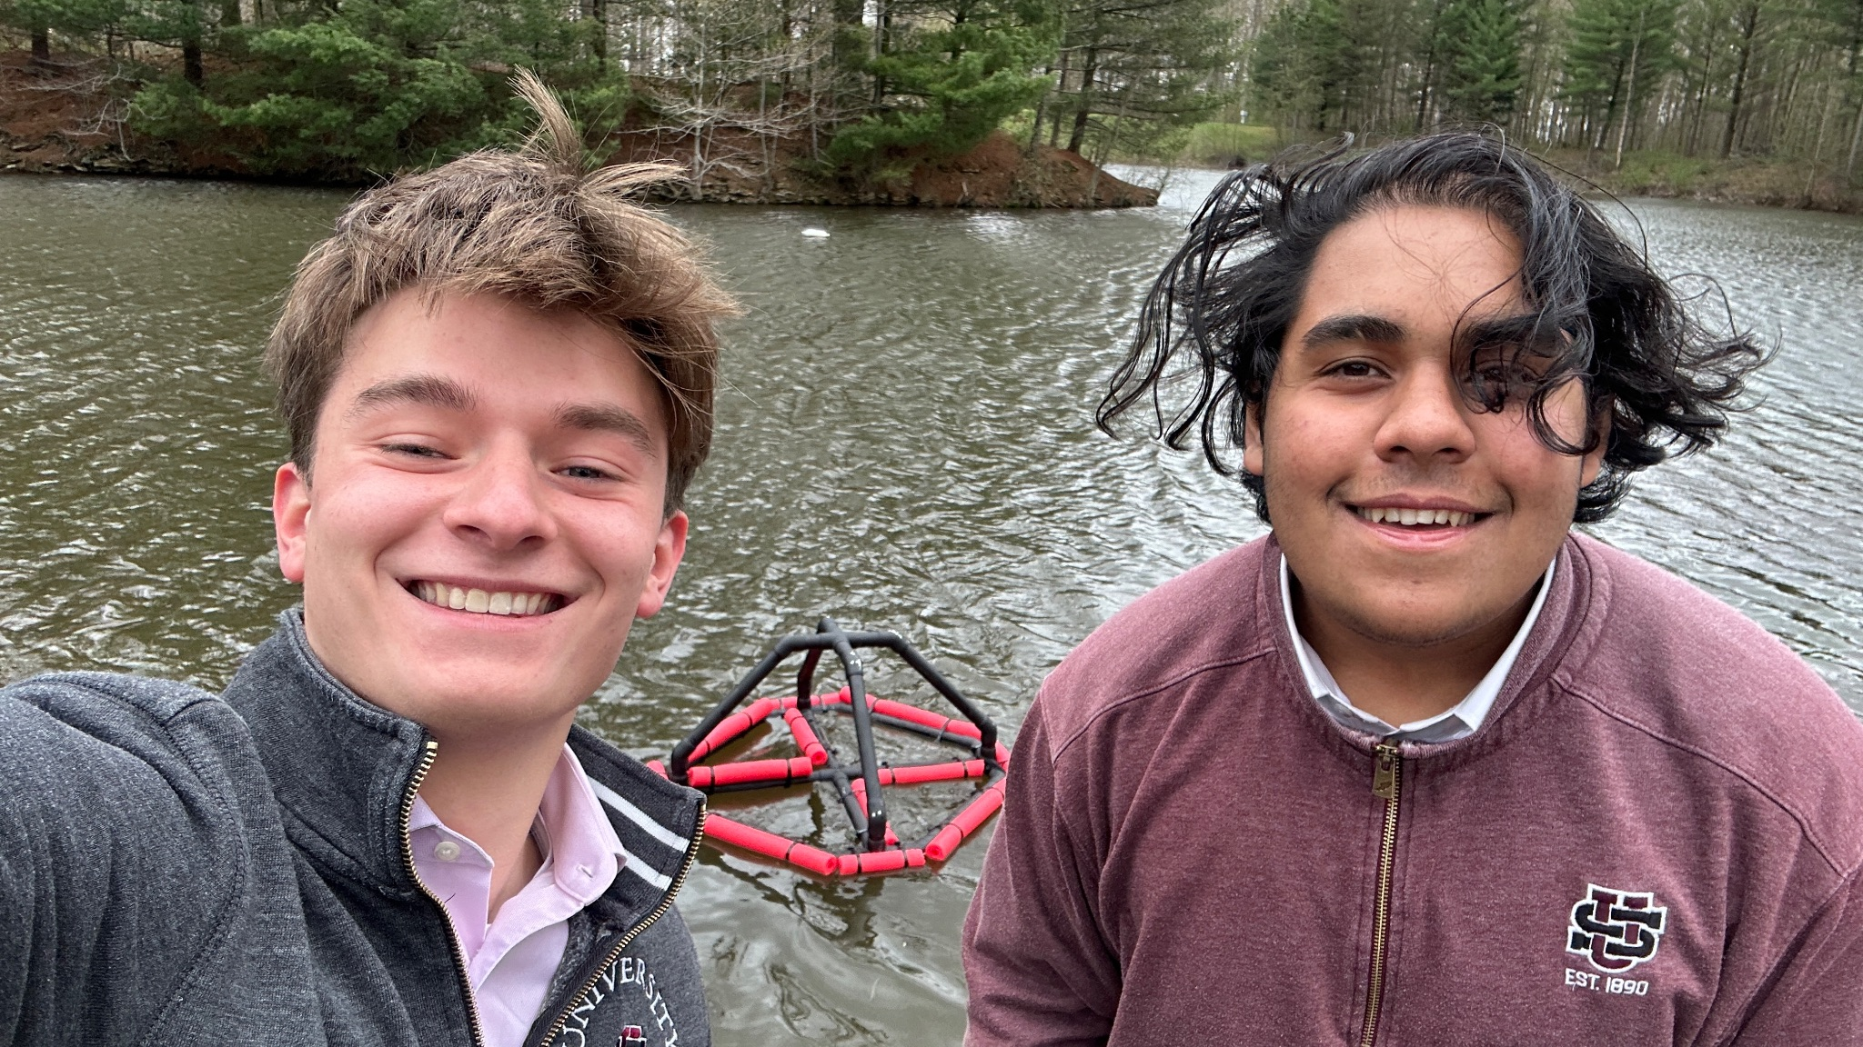
Next Year
The plan is to spend this summer troubleshooting and setting up the buoy to have the teachers use it.
As well portable units using the same technology will be used to study many of the stream and rivers around the US campus

Slide 24
Thank You
Mr. Mckeown
Nate Abbott
Mr. Starinsky
Mrs. Axelrod
Ben and Debbie Mathews
Jinisha and Ketal Patel
Jeffrey Adair
Mr. Brown
Mrs. Ulery
The Strnad Family
Mr. Harmon
Zain Anwar and Ryan wang
Kaden Jones and Arveen Alaeddini

Slide 25
Thanks

